Slide 1
GREEdy Technique

Slide 2
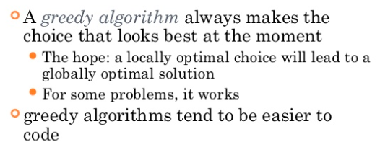
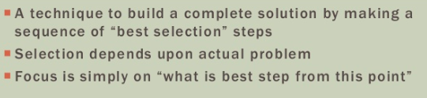
Introduction

Slide 3
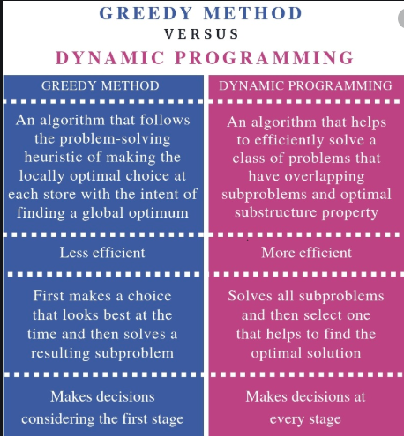

Slide 4
Examples
Minimum Spanning Tree – Prims, Kruskals algorithm
Dijkstra’s shortest path algorithm
Huffman Coding

Slide 5
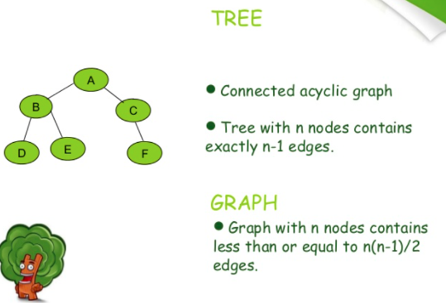

Slide 6
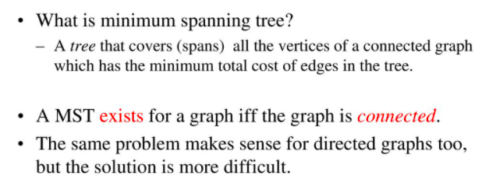

Slide 7
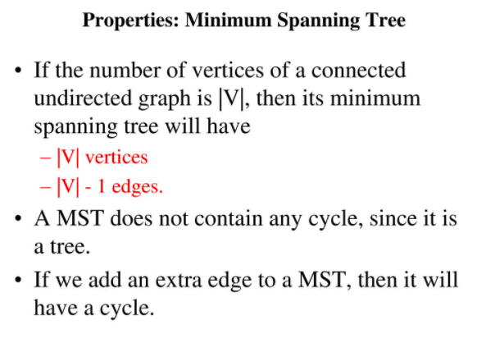

Slide 8
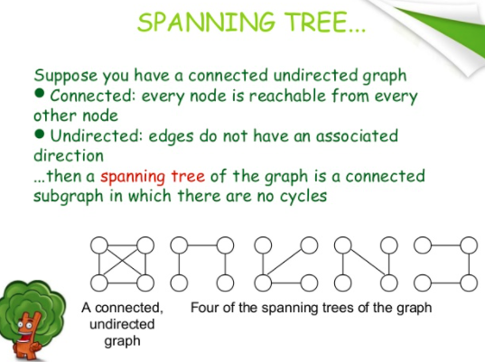

Slide 9
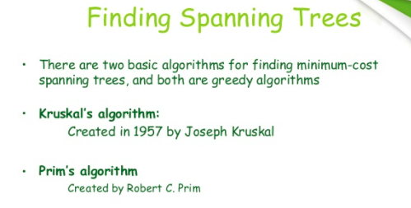

Slide 10
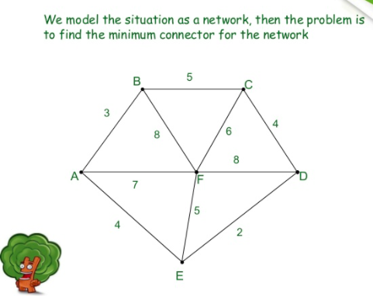

Slide 11
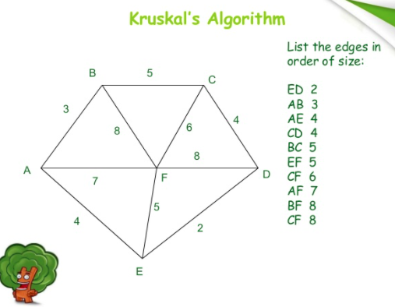

Slide 12
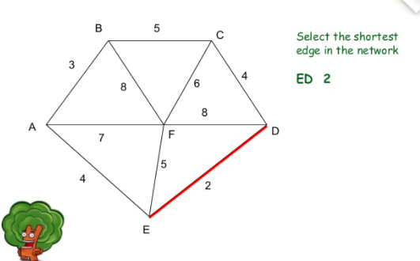

Slide 13
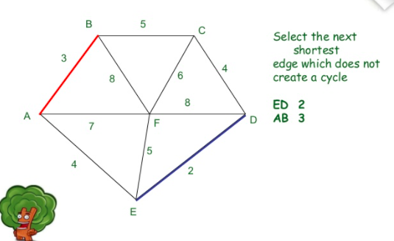

Slide 14
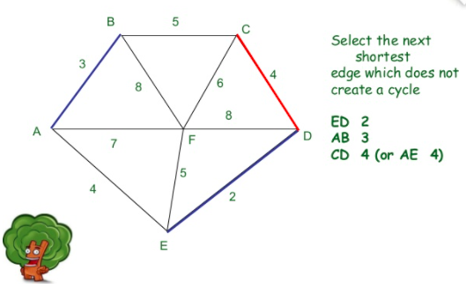

Slide 15
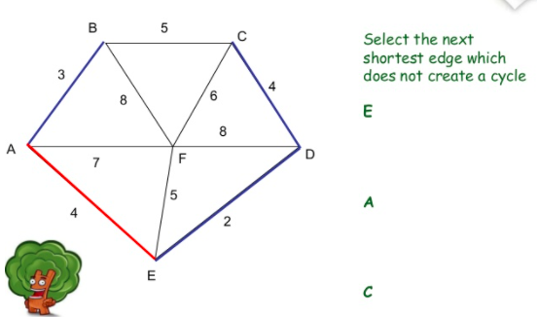

Slide 16
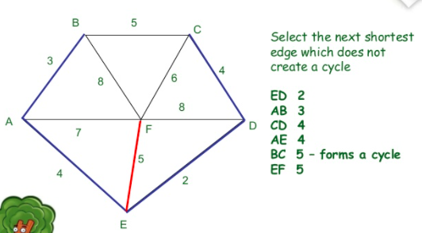

Slide 17
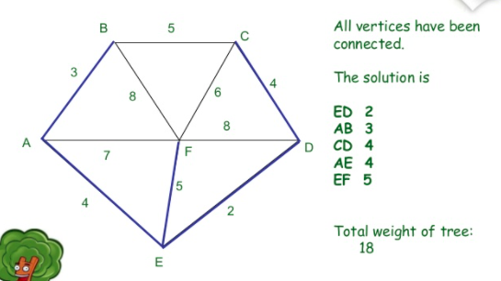

Slide 18
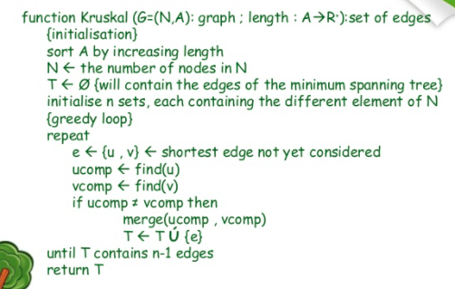
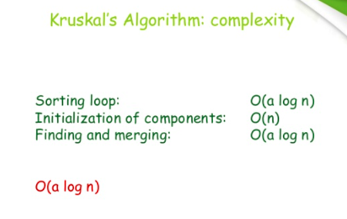

Slide 19
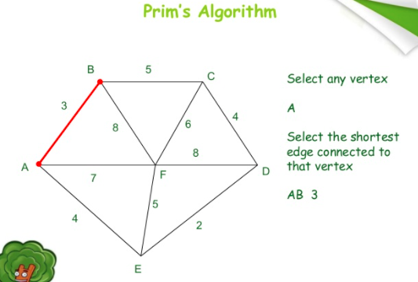

Slide 20
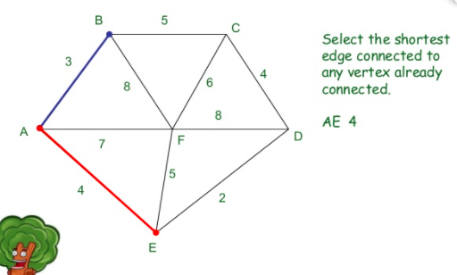

Slide 21
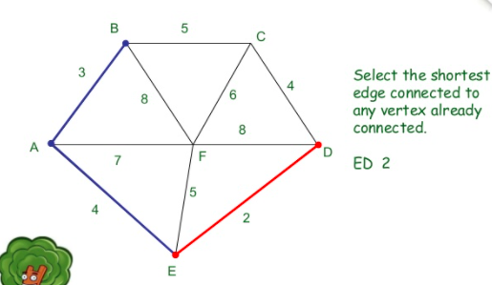

Slide 22
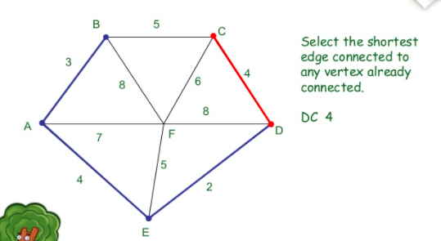

Slide 23
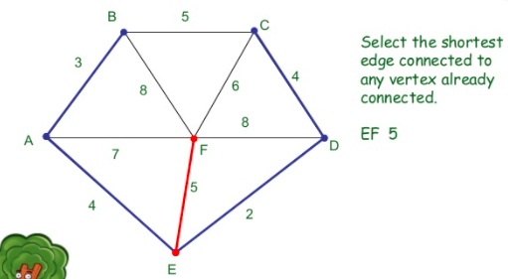

Slide 24
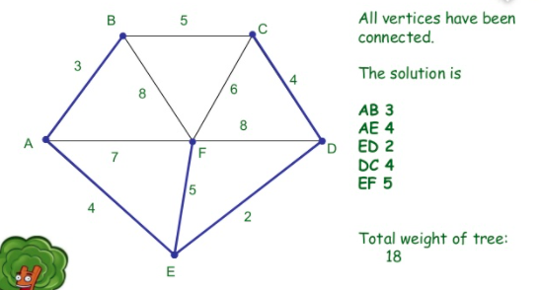

Slide 25
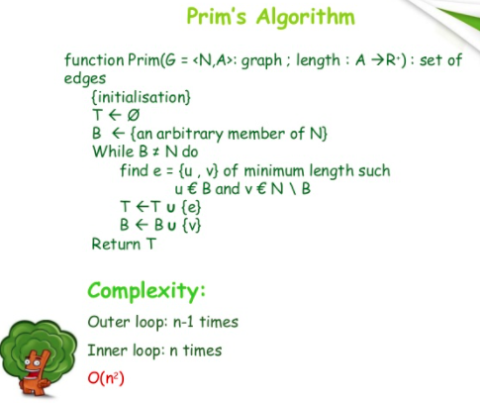

Slide 26
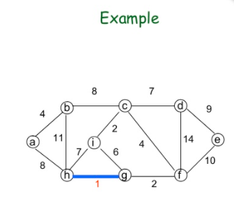

Slide 27
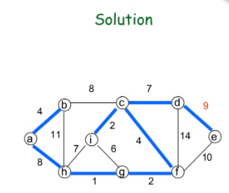

Slide 28
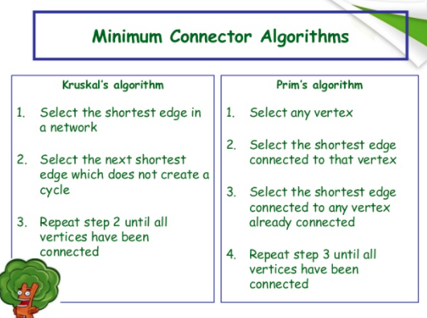

Slide 29
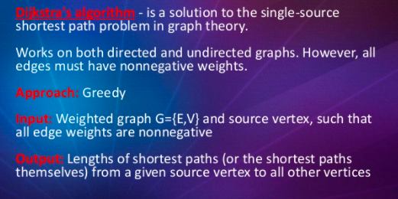
DIJKSTRA’S algorithm

Slide 30
a solution to the single-source shortest path problem in graph theory. Works on both directed and undirected graphs.
However, all edges must have nonnegative weights.
Approach: Greedy
Input: Weighted graph G={E,V} and source vertex, such that all edge weights are nonnegative
Output: Lengths of shortest paths (or the shortest paths themselves) from a given source vertex to all other vertices
This algorithm finds the path with lowest cost (i.e. the shortest path) between that vertex and every other vertex.
For example, if the vertices of the graph represent cities and edge path costs represent driving distances between pairs of cities connected by a direct road, Dijkstra's algorithm can be used to find the shortest route between one city and all other cities

Slide 31


Dijkstra’s Algorithm
T(n)=O($V^{2}$)
Dijkstra (G, s)
for each v in G.V{
if(v==s) $d_{s,v}$=0; else $d_{s,v}$= $∞;$//set the 0-edge shortest distance
from s to v
$π_{s,v}=NIL$; //set the predecessor of v on the shortest path
}
S=$∅;$//the set of vertices whose final shortest-path
weights have already been determined
Q=G.V;
while(Q $≠∅$){
u=Extract-Min(Q);
S=$S∪\{u\}$;
for all (u, v){//the greedy choice
if($d_{s,v}>d_{s,u}$+ $w_{(u,v)}$){
$d_{s,v}=d_{s,u}\text{+ }w_{(u,v)}$;
$π_{s,v}=u$;
}}}

Slide 32




Dijkstra’s Algorithm
The shortest path of the vertex with smallest distance is determined
1
$$∞$$
$$/10$$
$$∞$$
2
3
10
0
3
2
9
1
6
4
5
7
4
5
$$∞$$
$$/5$$
$$∞$$
2

Slide 33




Dijkstra’s Algorithm
Choose a vertex whose shortest path is now determined
1
10
$$/8$$
$$∞$$
$$/14$$
2
3
10
0
3
2
9
1
6
4
5
7
4
5
$$5$$
$$∞$$
$$/7$$
2

Slide 34



Dijkstra’s Algorithm
Choose a vertex whose shortest path is now determined
1
14
8
$$/13$$
2
3
10
0
$$/0$$
3
2
9
1
6
4
5
7
4
5
$$5$$
$$7$$
2

Slide 35

Dijkstra’s Algorithm
Choose a vertex whose shortest path is now determined
1
$$/9$$
8
13
2
3
10
0
3
2
9
1
6
4
5
7
4
5
$$5$$
$$/5$$
$$7$$
2

Slide 36

Dijkstra’s Algorithm
Choose a vertex whose shortest path is now determined
1
8
9
2
3
10
0
3
2
9
1
6
4
5
7
4
5
$$5$$
$$7$$
$$/7$$
2

Slide 37
Dijkstra’s Algorithm
Final result:
1
8
9
2
3
10
0
3
2
9
1
6
4
5
7
4
5
$$5$$
$$7$$
2
What is the shortest path from 1 to 5?
1, 4, 5
What is the shortest path from 1 to 2, 3, and 4?
What is weight of this path?
7

Slide 38
Reference - Dijkstra
https://www.freecodecamp.org/news/dijkstras-shortest-path-algorithm-visual-introduction/

Slide 39
Backtracking

Slide 40
Introduction
Backtracking is an algorithmic-technique for solving problems recursively by trying to build a solution incrementally, one piece at a time, removing those solutions that fail to satisfy the constraints of the problem at any point of time (by time, here, is referred to the time elapsed till reaching any level of the search tree).

Slide 41
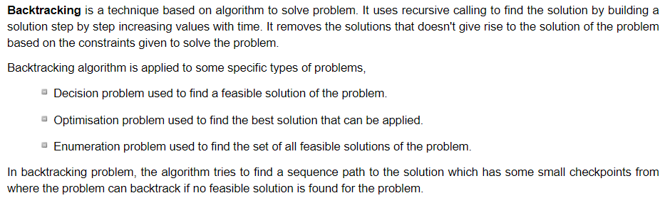

Slide 42
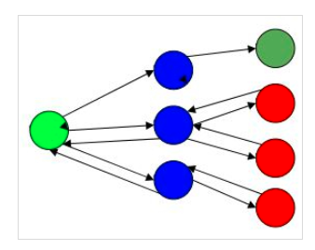
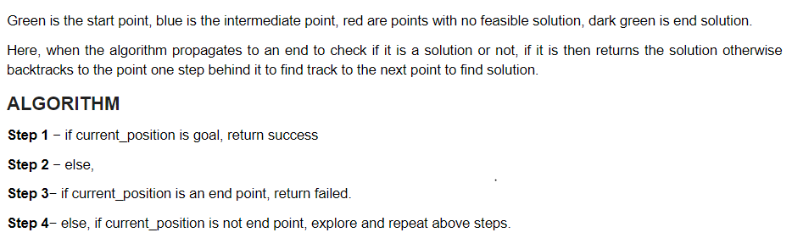

Slide 43
Sum of Subset problem
The problem is to find a subset of a given set S={s1,s2,….sN} of N positive integers whose sum is equal to a given positive integer “d”.
Sum of subset that is equivalent to given positive integer.

Slide 44

First step is to arrange the set in ascending order
Example – S={1,3,4,5} d=8
2 possible subsets – {1,3,4} {3,5}
Calculating through the state space tree. If no elements are inserted in the tree, start with node value as ‘0’

Slide 45
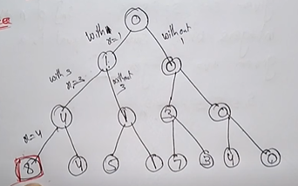
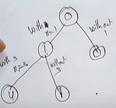

Slide 46
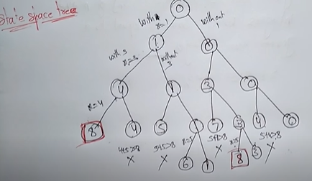

Slide 47
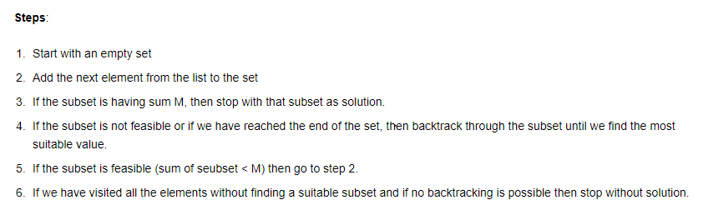
Pseudocode

